Slide 1
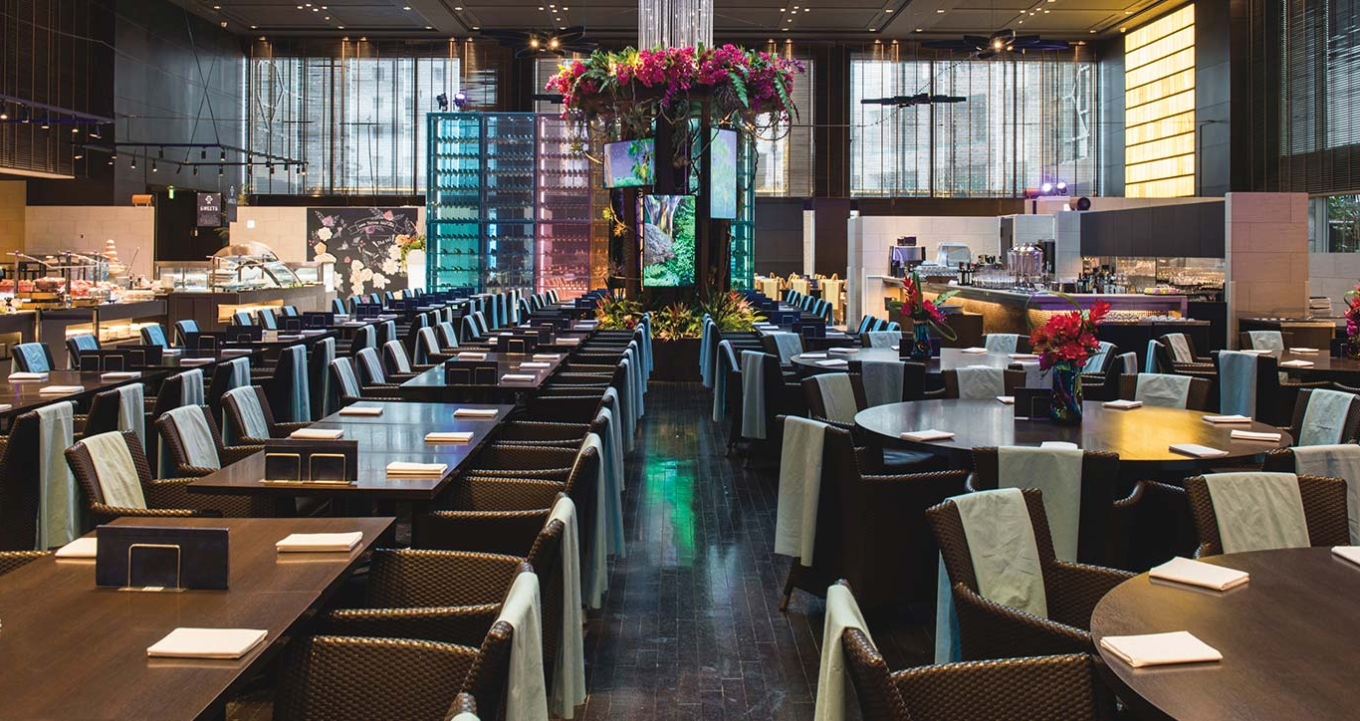
Meal Order Detail Analysis
Huiya Yu

Slide 2





Executive summary
Find out the busy time and busy day to arrange working time of employee, find out popular dishes and the factors which effect customers decision.
PROBLEM STATEMENT
METHODOLOGY
RESULTS
Figure out when is the busy time and the busy weekday ;
Define the popular dishes
Get some suggestions for the whisky to add in the drinking list
Correlation coefficient
Heatmap
Hypothesis test
Tableau
Modelling
Web Scaping
Popular dished
Busy time: 18 o clock
Busy Day: Friday and Saturday
Suggested whisky

Slide 3
Agenda
1
Staff Arrangement Plan
2
Popular Dishes Analyse
3
Factors Analyze
4
Additions to the Menu

Slide 4
Agenda
1
Staff Arrangement Plan
2
Popular Dishes Analyse
3
Factors Analyse
4
Additions to the Menu

Slide 5
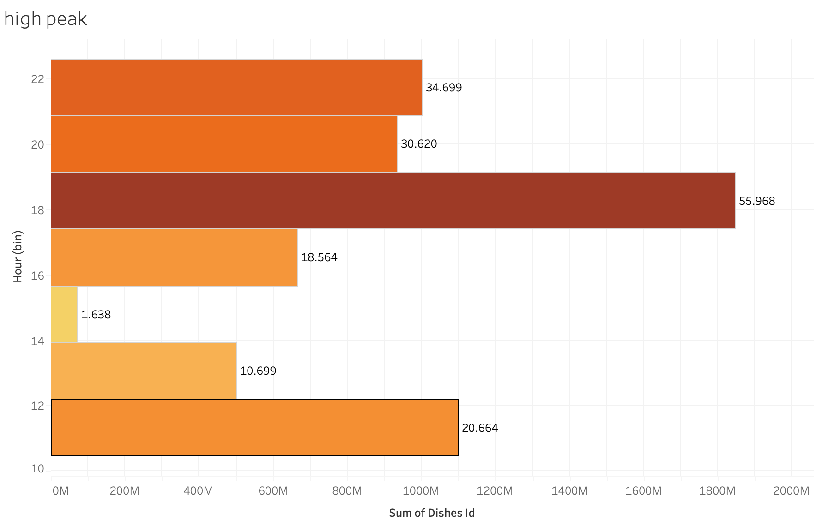
High Peak
Following shows the overview of order numbers in a day
18-20 o clock the restaurant has the most guests, followed by 10-12 o clock
Restaurant should arrange more staff during those time

Slide 6
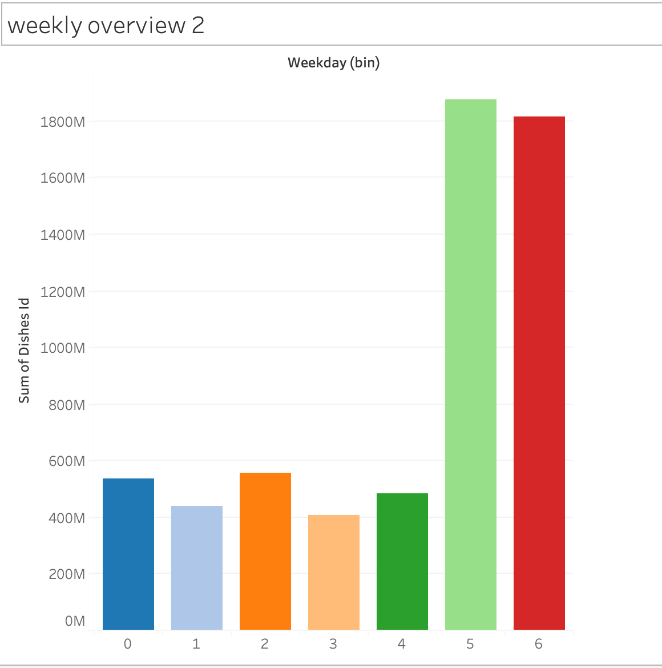
Weekly Overview
Following shows which day is the busy day during a week in general
On Friday and Saturday the restaurant expect the most guests.
Restaurant should arrange more staffs on those 2 days.

Slide 7
Agenda
1
Staff Arrangement Plan
2
Popular Dishes Analyse
3
Factors Analyse
4
Additions to the Menu

Slide 8
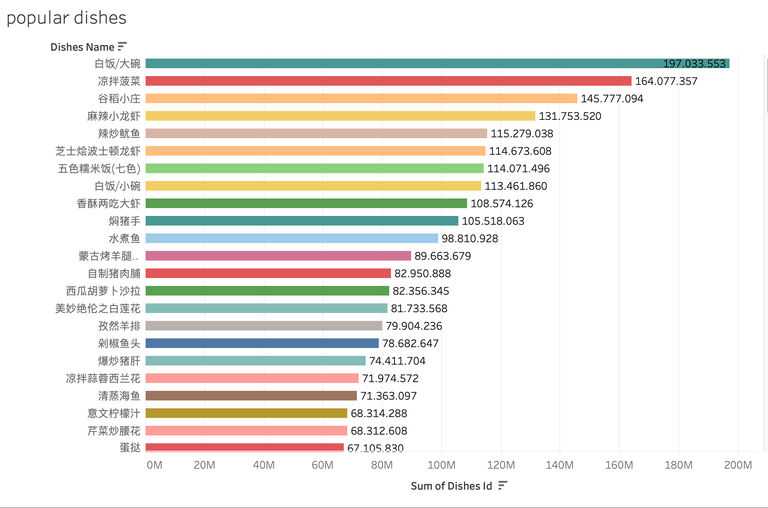
Popular Dishes Ranking
I exclude the side dished in the results because they can be done very quick
Some of them are side dishes, for those the restaurant doesn’t need to prepare before because they can be done very fast
So I got the restaurant as following :
The restaurant might need to prepare lobster, squid, shrimp, and fish

Slide 9
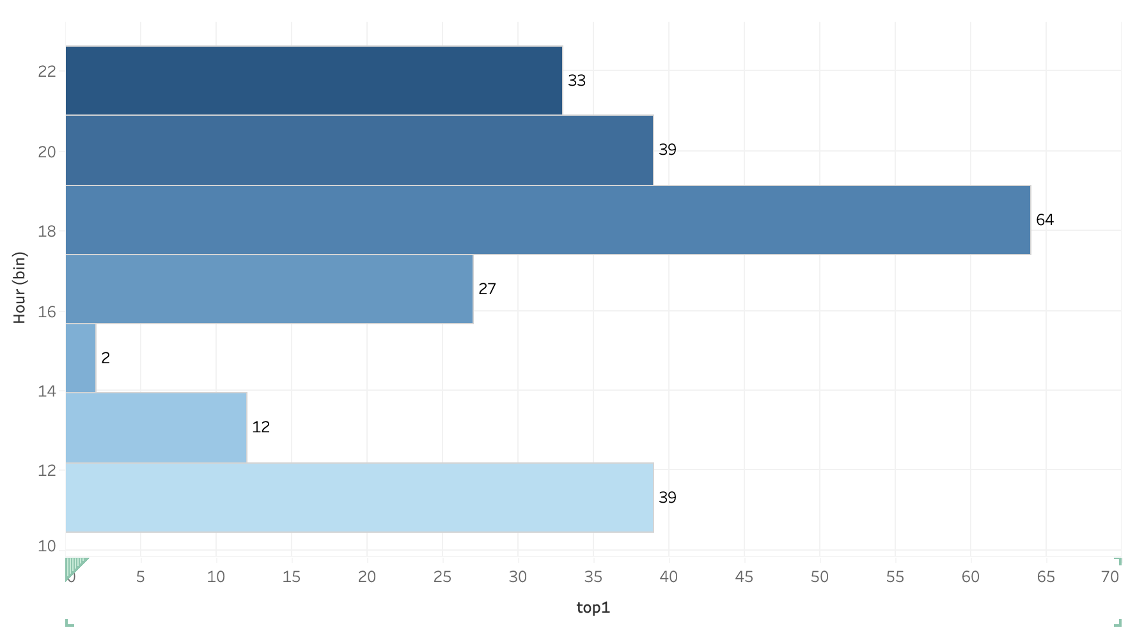
How much should they prepare for the dishes
Take the most popular dishes as example
At 18 the restaurant should prepare 64 lobster

Slide 10
Agenda
1
Staff Arrangement Plan
2
Popular Dishes Analyse
3
Factors Analyse
4
Additions to the Menu

Slide 11



Factors Analysis For orders
Price (Amounts)
Employee
Negative related
Positive related
Related
0.015
0.06
Coefficient
Price is not related to if the customer oder dishes
Employee could effect, maybe can train employee to recommond dishes
Insights
The popularity of of dishes is depends on the dishes themselves, and the employees‘ recommondations.

Slide 12
Agenda
1
Staff Arrangement Plan
2
Popular Dishes Analyse
3
Factors Analyse
4
Additions to the Menu

Slide 13
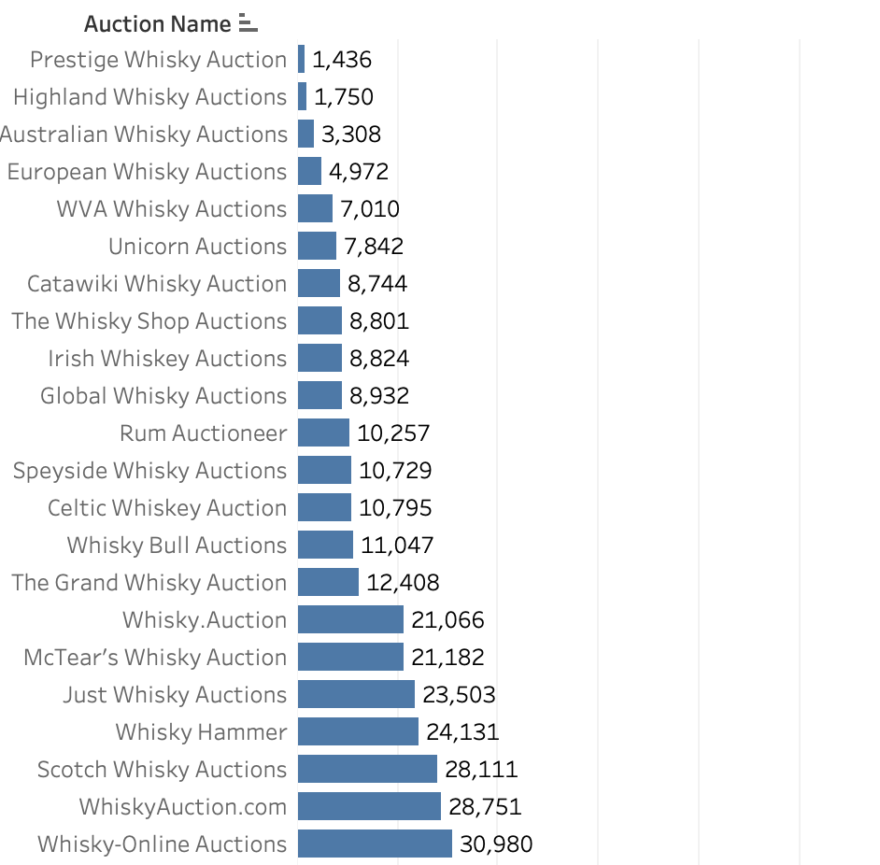
Suggestion for the Menu
Suggestion: To add more variation of the menu, restaurant can try to add whisky. Ranking is based on price

Slide 14

Thanks For Your Attention

